Slide 1
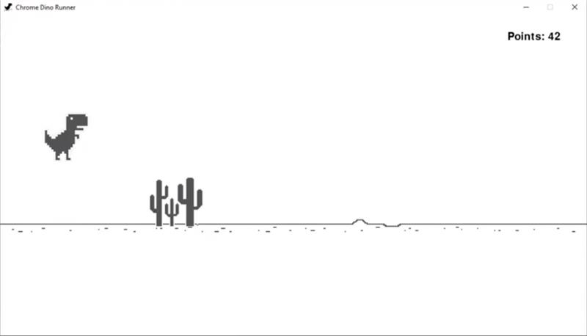
Dino Bot AI with QLearning
By: Nick Elliott and Emmanuel Audu

Slide 2
Business Problem
According to Statistics Canada, over 200,000 children have some form of mental disability in Canada
Research proves that gaming improves mental abilities and releases dopamine
This project is our first step at creating a model that aids mentally disabled kids at playing any game with Reinforced learning
But our scope is limited to the chrome dino game.

Slide 3
Technology Used
Language: Python
Python Packages:
Game creation - pygame
ML Environment - openAI gym
Machine Learning - tensorflow & keras
Previous version - selenium
Version Control: Github

Slide 4
Challenges During Execution
Implementing the game using Pygame
Understanding the Deep Learning Algorithms
Setting up the Environment for Tensorflow & Keras
Training the models

Slide 5
Potential Future Improvements
Current Project:
Further improve performance of our model
Allow for more customized user experience
Future Projects:
Apply technology to other games
Apply technology to other fields asides

Slide 6
Thank you

